Slide 1

Error Analysis
Learning Objectives:
Describe multi-task learning and transfer learning
Recognize bias, variance and data-mismatch by looking at the performances of your algorithm on train/dev/test sets

Slide 2
Error Analysis
1 Carrying out error analysis
2 Cleaning up Incorrectly labeled data
3 Build your first system quickly, then iterate
4 Training and testing on different distributions
5 Bias and Variance with mismatched data distributions
6 Addressing data mismatch
7 Transfer learning
8 Multi-task learning
9 What is end-to-end deep learning
10 Whether to use end-to-end learning

Slide 3
Error Analysis
Carrying out error
analysis

Slide 4
Carrying out error analysis
After identifying the categories of errors the algorithm is making, you can prioritize which ones to focus on and come up with potential solutions to address them, such as collecting more labeled data, adjusting the model architecture, or changing the optimization algorithm.
It is also important to track the impact of these changes on the development and test set performance to ensure that they are actually improving the algorithm's performance.
Notes:
Error analysis is a process in machine learning that involves manually examining mistakes made by a learning algorithm to gain insights into how to improve it.
It is particularly useful when the algorithm is not yet performing at the level of a human.
To carry out error analysis, you start by finding a set of mislabeled examples in your development set, and then manually examine them to see what categories of errors the algorithm is making.
- For example, in the case of a cat classifier that is misclassifying some dogs as cats, you might manually examine a set of 100 mislabeled dev set examples and count up how many of them are actually pictures of dogs.

Slide 5
Carrying out error analysis
By understanding the types of errors the model is making, machine learning engineers can prioritize their efforts and focus on the areas that will have the biggest impact on improving the model's performance.
Error analysis can reveal new categories of errors that were not previously considered and provide insights into how to improve the algorithm's performance.
By examining the errors in detail, you can identify patterns and trends that might not have been apparent otherwise. This can help you to develop more effective strategies for improving the algorithm's accuracy and efficiency.
Notes:
By counting up the number of errors that fall into various different categories, you can get a sense of how worthwhile it might be to work on each of these different categories of errors. This can help you prioritize your efforts and understand how promising different approaches are.
- For example, if a large percentage of the errors are due to blurry images or great cats being misclassified as small cats, then you might focus on improving performance in those areas.
During the error analysis process, you might also notice new categories of errors that you hadn't previously considered.
- For example, you might notice that image filters like those used in Instagram or Snapchat are causing errors in your classifier. In that case, you can create new categories during the process and count up the fraction of examples that are mislabeled in different ways.

Slide 6
Carrying out error analysis
Correcting mislabeled examples in development set is essential for accurate error analysis and algorithm training. This can be done manually or with the help of crowd-sourcing or other methods.
By correcting mislabeled examples, you can improve the accuracy of your error analysis and ensure that your algorithm is being trained on the correct data.
Notes:
If you find that some of the examples in your dev set are mislabeled, you should correct them as soon as possible. This can involve manually correcting the labels, or using crowd-sourcing or other methods to get additional labeling help. By doing this, you can ensure that your error analysis is more accurate and that your algorithm is trained on the correct data.

Slide 7


Look at dev examples to evaluate ideas
Should you try to make your cat classifier do better on dogs? Error analysis:
Get ~100 mislabeled dev set examples.
Count up how many are dogs.

Slide 8
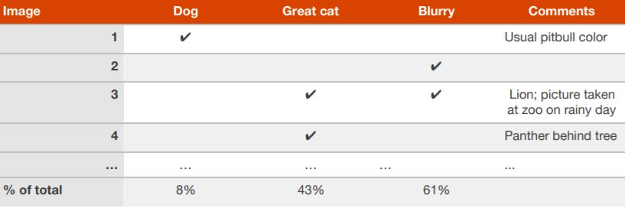
Evaluate multiple ideas in parallel
Ideas for cat detection:
Fix pictures of dogs being recognized as cats
Fix great cats (lions, panthers, etc..) being misrecognized
Improve performance on blurry images

Slide 9
Error Analysis
Cleaning up Incorrectly labeled data

Slide 10
Cleaning up Incorrectly labeled data
The process of supervised learning involves input X and output labels Y, and sometimes you may find that some of the Y labels are incorrect, meaning they were labeled incorrectly by a human labeler. These errors may or may not be worth fixing.
Deep learning algorithms are usually quite robust to random errors in the training set, as long as the errors are not systematic. So, random or near-random errors can be left as they are, and not much effort needs to be spent on fixing them. However, if the errors are systematic, then they could cause the algorithm to learn incorrectly.
Notes:
The process of supervised learning involves input X and output labels Y, and sometimes you may find that some of the Y labels are incorrect, meaning they were labeled incorrectly by a human labeler. These errors may or may not be worth fixing. Deep learning algorithms are usually quite robust to random errors in the training set, as long as the errors are not systematic. So, random or near-random errors can be left as they are, and not much effort needs to be spent on fixing them. However, if the errors are systematic, then they could cause the algorithm to learn incorrectly.

Slide 11
Cleaning up Incorrectly labeled data
Additionally, if you decide to fix the incorrect labels in your dev set or test set, it's important to make sure that you correct all instances of the incorrect label, not just the ones that you noticed during error analysis. You can do this by going through the entire dev or test set and checking all labels. Finally, it's important to note that fixing incorrect labels in the dev or test set may require retraining your algorithm, which can be time-consuming and may also require additional labeled data.
Notes:
In terms of the dev set or test set, if you find that the Y labels are incorrect, you can add an extra column during error analysis to count the number of examples where the label was wrong.
If the impact of the incorrect labels on your ability to evaluate algorithms on your dev set is significant, it may be worth fixing them. To determine if it is worth fixing the incorrect labels, you should look at the overall dev set error, the percentage of errors due to incorrect labels, and the percentage of errors due to other causes. If the percentage of errors due to incorrect labels is high, then it may be worth fixing them.

Slide 12
Cleaning up Incorrectly labeled data
Error analysis is indeed a crucial step in improving the accuracy of machine learning algorithms. By examining the errors made by the algorithm, you can gain insights into what areas need improvement and prioritize your efforts accordingly.
Notes:
If you decide to fix the incorrect labels, you should apply the same process to both the dev set and the test set, and you should consider examining examples that your algorithm got right, as well as ones it got wrong. It is not always necessary to correct the labels in your training set, as deep learning algorithms are usually quite robust to random errors in the training set. However, it is important that your dev and test sets come from the same distribution.
In conclusion, error analysis is an important part of building practical machine learning systems. It may require manual effort to examine the data and count the number of errors, but it can help you prioritize where to go next and improve the accuracy of your algorithms.

Slide 13

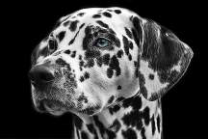





Incorrectly labeled examples
x
y
1
0
1
1
0
1
1
DL algorithms are quite robust to random errors in the training set.

Slide 14

Error analysis
Image | Dog | Great Cat | Blurry | Incorrectly labeled | Comments
…
98 |  |  |  | ✓ | Labeler missed cat in background
99 |  | ✓
100 |  |  |  | ✓ | Drawing of a cat; Not a real cat.
% of total | 8% | 43% | 61% | 6%
Overall dev set error 10% 2%
Errors due incorrect labels 0.6% 0.6%
Errors due to other causes 9.4% 1.4%
Goal of dev set is to help you select between two classifiers A & B.

Slide 15
Correcting incorrect dev/test set examples
Apply same process to your dev and test sets to make sure they continue to come from the same distribution
Consider examining examples your algorithm got right as well as ones it got wrong.
Train and dev/test data may now come from slightly different distributions.

Slide 16
Error Analysis
Build your first system quickly, then iterate

Slide 17
Build your first system quickly, then iterate
When building a machine learning application, it can be overwhelming to decide which techniques to prioritize. To tackle this challenge, it is recommended to quickly build an initial system, set up a dev/test set and metric, and evaluate the performance of the system against the set and metric. Then, use bias/variance analysis and error analysis to identify areas for improvement and prioritize the next steps accordingly. This iterative process can help to gradually improve the system and achieve better performance.
Notes:
When building a new machine learning application, there can be many different directions and techniques you could prioritize to improve the system. This can make it challenging to know where to start, especially if you're not an expert in the particular application area. To overcome this challenge, the advice given is to build your first system quickly and then iterate.
The first step is to set up a dev/test set and metric to help you decide where to place your target. Then, you can build an initial machine learning system quickly, train it, and see how well it performs against your dev/test set and valuation metric. This initial system will help you to prioritize the next steps by using bias/variance analysis and error analysis to identify the areas where improvements can be made.

Slide 18
Build your first system quickly, then iterate
The initial system in machine learning helps to identify bias and variance, prioritize improvements, and avoid overthinking or making the system too complex.
This approach is particularly useful for those who are new to the problem or lack expertise in the application area.
However, for those with significant prior experience or a significant body of literature to draw from, it may be appropriate to build a more complex system from the start.
Notes:
By having some learned system, you can localize bias/variance, prioritize what to do next, and figure out which improvements are the most worthwhile. The value of the initial system lies in its ability to help you focus your efforts and avoid overthinking or making your first system too complicated.
This advice applies less strongly if you have significant prior experience in the application area or if there is a significant body of academic literature to draw on for the exact same problem you're building. In these cases, it may be okay to build a more complex system from the get-go. However, if you're tackling a new problem for the first time, building something quick and dirty and then using it to prioritize improvements can be a more effective approach.

Slide 19
Build your first system quickly, then iterate
Overall, the goal of building a machine learning application is to get something that works well. By building your first system quickly and then iterating based on bias/variance analysis and error analysis, you can improve the system and prioritize the areas where the most significant improvements can be made.

Slide 20
Speech recognition example
Noisy background
Café noise
Car noise
Accented speech
Far from microphone
Young children’s speech
Stuttering
…
Set up dev/test set and metric
Build initial system quickly
Use Bias/Variance
analysis & Error
analysis to prioritize next steps.

Slide 21
Mismatched training and dev/test data
Training and testing on different distributions

Slide 22
Training and testing on different
distributions
A lot of teams are working with deep learning applications that have training sets that are different from the dev/test sets due to the hunger of deep learning to data.
There are some strategies to follow up when training set distribution differs from dev/test sets distribution (see the next slide).
Notes:
By having some learned system, you can localize bias/variance, prioritize what to do next, and figure out which improvements are the most worthwhile. The value of the initial system lies in its ability to help you focus your efforts and avoid overthinking or making your first system too complicated.
This advice applies less strongly if you have significant prior experience in the application area or if there is a significant body of academic literature to draw on for the exact same problem you're building. In these cases, it may be okay to build a more complex system from the get-go. However, if you're tackling a new problem for the first time, building something quick and dirty and then using it to prioritize improvements can be a more effective approach.

Slide 23
Training and testing on different
distributions
1. Option one (not recommended): shuffle all the data together and extract randomly training and dev/test sets.
- Advantages: all the sets now come from the same distribution.
- Disadvantages: the other (real world) distribution that was in the dev/test sets will occur less in the new dev/test sets and that might be not what you want to achieve.
2. Option two: take some of the dev/test set examples and add them to the training set.
- Advantages: the distribution you care about is your target now. - Disadvantage: the distributions in training and dev/test sets are now different. But you will get a better performance over a long time.
Notes:
By having some learned system, you can localize bias/variance, prioritize what to do next, and figure out which improvements are the most worthwhile. The value of the initial system lies in its ability to help you focus your efforts and avoid overthinking or making your first system too complicated.
This advice applies less strongly if you have significant prior experience in the application area or if there is a significant body of academic literature to draw on for the exact same problem you're building. In these cases, it may be okay to build a more complex system from the get-go. However, if you're tackling a new problem for the first time, building something quick and dirty and then using it to prioritize improvements can be a more effective approach.

Slide 24






Cat app example
Data from webpages
Data from mobile app

Slide 25
Cat app example
There are two sources of data used to develop the mobile app.
The first data distribution is small, 10 000 pictures uploaded from the mobile application. Since they are from amateur users, the pictures are not professionally shot, not well framed and blurrier.
The second source is from the web, you downloaded 200 000 pictures where cat's pictures are professionally framed and in high resolution.
The problem is that you have a different distribution:
Small data set from pictures uploaded by users. This distribution is important for the mobile app.
Bigger data set from the web.
The guideline used is that you have to choose a development set and test set to reflect data you expect to get in the future and consider important to do well.

Slide 26
Cat app example
Option 1: randomly shuffle 210,000 images into a train, dev, and test set
Train Dev Test
Advantage: training, dev and test sets will all come from the same distribution, so that makes it easier to manage.
Disadvantage: in dev set, of these 2,500 examples, a lot of it will come from the web page distribution of images, rather than what you actually care about, which is the mobile app distribution of images.
205,000 | 2,500 | 2,500

Slide 27
Cat app example
Option 2: the training set will include 200,000 images from the web and 5,000 from the mobile app. The dev set will be 2,500 images from the mobile app, and the test set will be 2,500 images also from the mobile app
Train App Dev (app) Test(app)
Advantage: the target is well defined.
Disadvantage: the training distribution is different from the development and test set distributions. However, this way of splitting the data has a better performance in long term..
200,000 | 205,000 | 2,500 | 2,500

Slide 28
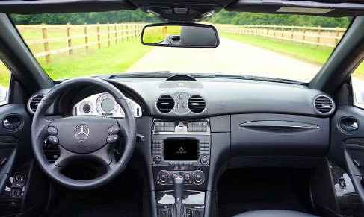
Speech recognition example
A speech activated rearview mirror for a car
Training: 500,000 utterences from:
- Purchased data
- Smart voice activated speakers
- Voice activated keyboards
…
Dev/test: 20,000 utterences from:
- A speech activated rearview mirror.

Slide 29
Speech recognition example
Option 1: the training set includes the 500,000 utterances and the dev and test sets 10,000 utterances each.
Train Dev Test
Option 2: the training set includes all 500 from there and 10,000 from the rearview mirror, the dev and test sets include 5,000 utterances each.
Train Dev Test
500,000 | 10,000 | 10,000
500,000 + 10,000 | 5,000 | 5,000

Slide 30
Training and testing on different distributions
When allowing your training set data to come from a different distribution than your dev and test set allows you to have much more training data and it will cause your learning algorithm to perform better.

Slide 31
Mismatched training and dev/test data
Bias and Variance with mismatched data distributions

Slide 32
Bias and Variance with mismatched data distributions
To assess bias and variance discrepancies arising from different data distributions, a training-dev set, reflecting the training set's distribution, can be utilized.
Analyzing the classifier's errors on the training, training-dev, and dev sets aids in identifying avoidable bias, variance, and data mismatch issues. Addressing data mismatch involves monitoring the model's performance and making necessary adjustments to enhance its generalization.
Notes:
To analyze bias and variance when the training set comes from a different distribution than the dev and test sets, one can create a new subset of data called the training-dev set that has the same distribution as the training set but is not explicitly trained on.
By analyzing the error of the classifier on the training set, training-dev set, and dev set, one can determine the degree of avoidable bias, variance, and data mismatch problems. Training on data from different distributions can help address data mismatch, but there are no systematic ways to do so. Therefore, it is important to carefully monitor the performance of the model and make necessary adjustments to improve its generalization capability.

Slide 33
Cat classifier example
Assume humans get ≈ 0% error.
Training error
Dev error
Training-dev set: Same distribution as training set, but not used for training

Slide 34
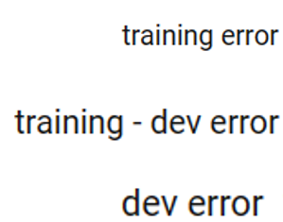



Bias/variance on mismatched training and dev/test sets

Slide 35
Mismatched training and dev/test data
Addressing data mismatch

Slide 36
Addressing data mismatch
There aren't completely systematic solutions to this, but there are some things you could try.
Carry out manual error analysis to try to understand the difference between training and dev/test sets.
Make training data more similar, or collect more data similar to dev/test sets.
If your goal is to make the training data more similar to your dev set one of the techniques you can use Artificial data synthesis that can help you make more training data.
- Combine some of your training data with something that can convert it to the dev/test set distribution. Examples:
1. Combine normal audio with car noise to get audio with car noise example.
2. Generate cars using 3D graphics in a car classification example.
- Be cautious and bear in mind whether or not you might be accidentally simulating data only from a tiny subset of the space of all possible examples because your NN might overfit these generated data (like particular car noise or a particular design of 3D graphics cars).
Notes:
Learning from multiple types of data at the same time, also known as multi-task learning, can be a powerful technique for improving performance on multiple related tasks. The basic idea is that instead of training a separate neural network for each task, you train a single neural network that can perform well on all tasks simultaneously. Multi-task learning can be especially useful when the tasks share some common structure or information.
For example, suppose you are building a system for detecting emotions in text. You might have different tasks for detecting anger, sadness, and happiness. One approach would be to train separate neural networks for each task. However, you might find that these tasks share some common structure, such as certain words or phrases that are associated with specific emotions. In this case, you could use multi-task learning to train a single neural network that can detect all three emotions simultaneously.
There are a few key challenges when it comes to multi-task learning.
- One is determining how much to weight each task during training. You don't want to give too much weight to one task at the expense of the others, but you also don't want to give equal weight to all tasks if some are more important than others.
- Another challenge is determining how to share information between the tasks. You want to allow the network to learn from each task, but you also want to ensure that the network is not overfitting to one task at the expense of the others.
One common approach to multi-task learning is to use a shared representation. This means that you have a single neural network that takes in all the inputs for all the tasks, and then learns a common representation that is used for all tasks. This can be useful for capturing common structure between the tasks.
Another approach is to use task-specific layers, where each task has its own set of layers that are trained on top of the shared representation. This can be useful for capturing task-specific information.
Overall, multi-task learning can be a powerful technique for improving performance on related tasks. By leveraging common structure between the tasks, you can train a single neural network that can perform well on multiple tasks simultaneously. However, there are also some challenges to multi-task learning, such as determining how much to weight each task and how to share information between the tasks.

Slide 37

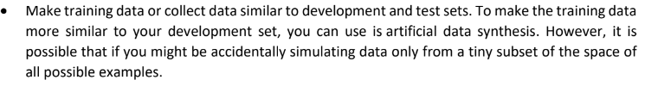
Artificial data synthesis
+
=
“The quick brown fox jumps
over the lazy dog.”
Car noise
Synthesized in-car audio

Slide 38



Artificial data synthesis
Car recognition:

Slide 39
Learning from multiple tasks
Transfer learning

Slide 40
Transfer learning
Transfer learning is a technique in deep learning that enables one to take knowledge learned from a neural network on one task and apply it to another task. This is particularly useful when you have a significant amount of data for the task you're transferring from but relatively little data for the task you're transferring to.
To implement transfer learning, you train a neural network on the source task and then remove the last output layer and create a new set of randomly initialized weights for the last layer to output the target task. Depending on the amount of data, you may retrain only the last layer's weights or all the layers' weights.
Transfer learning is useful when the input for both tasks is the same, and there is more data for the source task than for the target task. It is also helpful when low-level features from the source task could be beneficial for learning the target task.
Notes:
Transfer learning is a powerful idea in deep learning, where you can take the knowledge a neural network has learned from one task and apply it to a separate task. This is especially useful when you have a lot of data for the task you're transferring from and relatively little data for the task you're transferring to.
- For example, if you've trained a neural network on image recognition with a million images and now you want to build a radiology diagnosis system with only a hundred x-ray scans, you can transfer the knowledge learned from image recognition to radiology diagnosis.
To implement transfer learning, you first train a neural network on the source task, such as image recognition. Then, you remove the last output layer and create a new set of randomly initialized weights for the last layer to output the target task, such as radiology diagnosis. Depending on the amount of data you have, you may retrain only the last layer's weights or all the layers' weights.
Transfer learning makes sense when the input for both tasks is the same, such as images or audio clips. It also makes sense when there is more data for the source task than for the target task and when low-level features from the source task could be helpful for learning the target task.

Slide 41
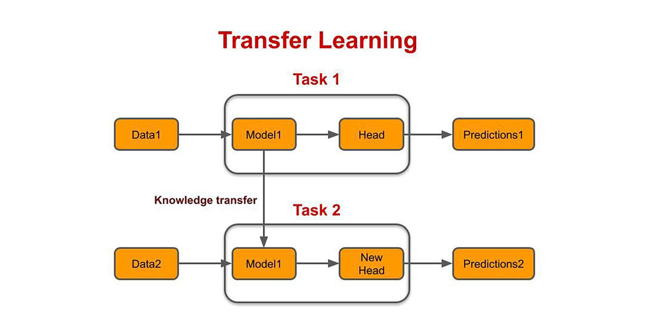
Transfer learning

Slide 42
When transfer learning makes sense
Task A and B have the same input x.
You have a lot more data for Task A than Task B.
Low level features from A could be helpful for learning B.

Slide 43
Transfer learning
In summary, transfer learning has been most useful when you're trying to do well on a problem with relatively little data, such as radiology diagnosis. It helps the performance of the learning task significantly when the conditions for transfer learning are met. However, transfer learning may not be helpful if the source task has less data than the target task.
Multitask learning is another version of learning from multiple tasks simultaneously, and it will be discussed in the next section.

Slide 44
Learning from multiple tasks
Multi-task learning

Slide 45
Multi-task learning
Whereas in transfer learning, you have a sequential process where you learn from task A and then transfer that to task B. In multi-task learning, you start off simultaneously, trying to have one neural network do several things at the same time. And then each of these tasks helps hopefully all of the other tasks.
Example: You want to build an object recognition system that detects pedestrians, cars, stop signs, and traffic lights (image has multiple labels).
Notes:
In traditional machine learning pipelines, the input data goes through several stages of processing, such as feature extraction, feature selection, and then finally prediction. End-to-end deep learning, on the other hand, seeks to learn a complete task from raw input data to the final output, without the need for manual feature engineering or other intermediate steps.
In end-to-end learning, the neural network takes raw input data as its input, and directly outputs the final prediction or output. The neural network is trained end-to-end using backpropagation, adjusting the weights and biases of the network to minimize the error or loss between the predicted output and the ground truth labels.
One benefit of end-to-end learning is that it can often produce better results than traditional machine learning pipelines, especially when dealing with complex tasks that have many intermediate steps.
Another advantage is that it can be more efficient, since it eliminates the need for manual feature engineering and other intermediate steps, which can be time-consuming and error-prone.
Some examples of end-to-end deep learning applications include image classification, object detection, speech recognition, and natural language processing. In these applications, the neural network takes the raw input data, such as images or audio, and directly outputs the final prediction, such as the class of the image or the text transcription of the speech.
However, end-to-end learning is not always the best approach for every task. For example, in some cases, it may be more efficient or accurate to use a traditional machine learning pipeline with manual feature engineering. Additionally, end-to-end learning can require large amounts of data and computing resources to train the neural network, which may not be feasible in some settings.
Overall, end-to-end learning is a powerful technique in deep learning that can automate the entire machine learning pipeline, from raw input data to final output, without the need for manual feature engineering or other intermediate steps.

Slide 46
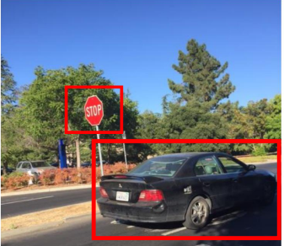
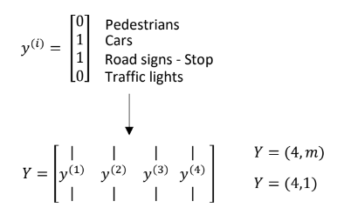
Simplified autonomous driving example

Slide 47
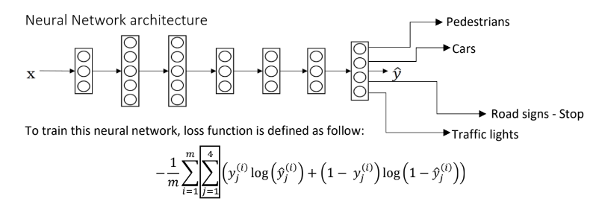
Neural network architecture

Slide 48
When multi-task learning makes sense
Training on a set of tasks that could benefit from having shared lower-level features.
Usually: Amount of data you have for each task is quite similar.
Can train a big enough neural network to do well on all the tasks.

Slide 49
Multi-task learning
If you can train a big enough NN, the performance of the multi-task learning compared to splitting the tasks is better.
Today transfer learning is used more often than multi-task learning.

Slide 50
End-to-end deep learning
What is end-to-end
deep learning

Slide 51
What is end-to-end deep learning
End-to-end deep learning is a technique that aims to replace multiple stages of processing with a single neural network, making it simpler and more efficient. While traditional data processing systems require multiple stages to achieve a goal, end-to-end learning trains a single neural network to input the data and output the final prediction directly.
However, end-to-end learning requires a large amount of data to work well, and may not work for all tasks. In some cases, intermediate approaches that break down the problem into multiple steps may be more effective. Therefore, researchers should consider the nature of the task and the availability of data when deciding whether to use end-to-end deep learning or other approaches.
Notes:
End-to-end learning is a deep learning approach that aims to replace multiple stages of processing with a single neural network. Traditionally, many data processing systems required multiple stages of processing to achieve a goal.
- For instance, speech recognition systems needed to extract hand- designed features of the audio, apply machine learning algorithms to find the phonemes in the audio clip, string together phonemes to form individual words, and then string those together to form the transcripts of the audio clip. In contrast, end-to-end deep learning can train a single neural network to input the audio clip and output the transcript directly.
However, end-to-end deep learning requires a large amount of data before it works well. There are also intermediate approaches where the neural network learns to output the phonemes of the audio clip and then undergoes other stages.
End-to-end learning works better for some tasks than others. For example, it works well for machine translation, where large datasets of English-French sentence pairs are available.
However, it may not work as well for tasks like estimating the age of a child from an X-ray image, where breaking down the problem into two steps may be more effective. In this case, step one involves recognizing the bones in the image, and step two involves estimating the age of the child based on the lengths of the bones.
In conclusion, end-to-end deep learning is an exciting development in deep learning that can simplify complex machine learning systems. However, it is not always the best approach and requires large amounts of data to work well. Researchers should consider the nature of the task and the availability of data when deciding whether to use end-to-end deep learning or other approaches.

Slide 52
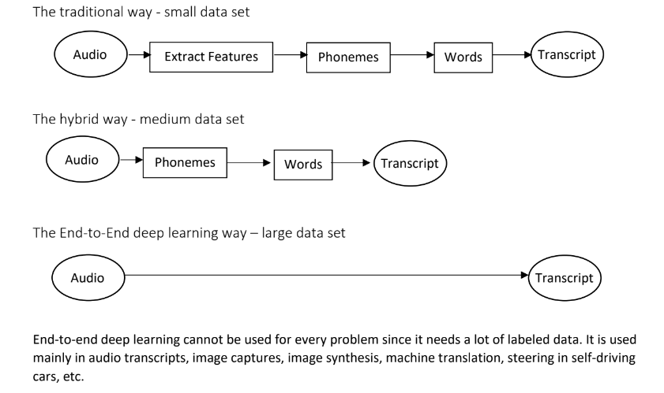
What is end-to-end learning?
Speech recognition example

Slide 53
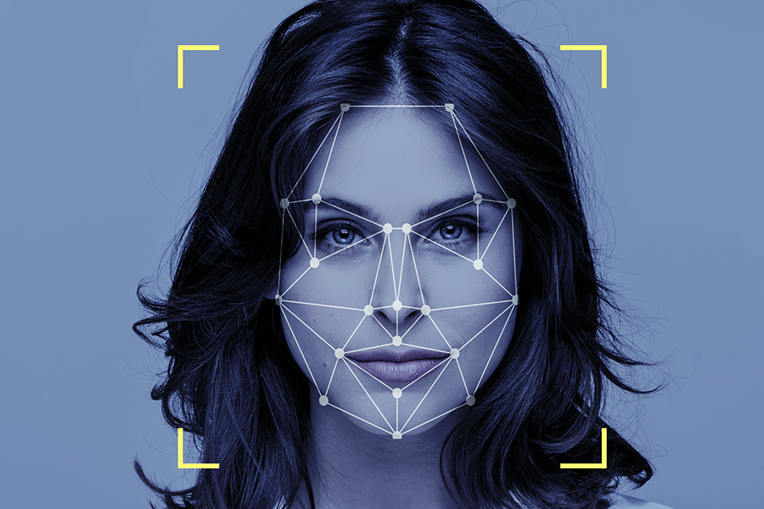

Face recognition
[Image courtesy of Baidu]

Slide 54



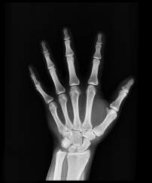

More examples
Machine translation
Estimating child’s age:

Slide 55
End-to-end deep learning
Whether to use end-to-end learning

Slide 56
Whether to use end-to-end learning
In machine learning, an end-to-end approach involves feeding input data directly into the algorithm and getting the output as the final result, without any intermediate steps or manual feature engineering. This approach can be beneficial as it allows the algorithm to capture complex statistics present in the data without being limited by human preconceptions.
However, it may require a large amount of data to learn the direct mapping from input to output, and hand-designed components may be useful for learning from less data. Therefore, it is essential to consider the complexity of the problem and the availability of data before deciding whether to use end-to-end deep learning or a combination of machine learning and hand-designed components.
While end-to-end deep learning can work well for certain tasks, it is important to be mindful of where it is applied to create more effective and efficient systems.
Notes:
In machine learning, an end-to-end approach refers to a system where the input data is fed directly into the algorithm and the output is the final result, without any intermediate steps or manual feature engineering. One of the benefits of this approach is that it allows the data to speak for itself, and the algorithm can capture whatever statistics are in the data rather than being forced to reflect human preconceptions. This can result in better performance when dealing with complex problems that are difficult to hand design features for.
However, one downside of end-to-end deep learning is that it may require a large amount of data to learn the complex mapping from input to output directly. Another disadvantage is that it excludes potentially useful hand-designed components, which can be helpful when dealing with a small training set. In such cases, hand-designed components can help inject human knowledge into the algorithm, and they can be helpful for learning more from less data.
When deciding whether or not to use end-to-end deep learning, one should consider the complexity of the task and whether or not there is sufficient data to learn the function mapping from input to output directly. In some cases, it may be more promising to use a combination of machine learning and hand-designed components to solve a problem. For example, in autonomous driving, deep learning can be used to detect other cars and pedestrians, but motion planning and control algorithms may be needed to plan and execute the car's route safely.
In summary, while end-to-end deep learning can sometimes work well, it is important to be mindful of where it is applied and whether or not there is sufficient data to support it. By carefully choosing what types of X to Y mappings to learn and considering the availability of data, machine learning engineers can create more effective and efficient systems.

Slide 57
Pros and cons of end-to-end deep learning
Pros:
Let the data speak
Less hand-designing of components needed
Cons:
May need large amount of data
Excludes potentially useful hand-designed components

Slide 58


Applying end-to-end deep learning
Key question: Do you have sufficient data to learn a function of the complexity needed to map x to y?

Slide 59
Summarization
Error analysis identifies patterns, prioritizes improvements, and refines training.
Correcting inaccuracies in labeled data involves careful examination and validation.
Building an initial model quickly establishes a baseline for iterative improvements.
Consistent data distribution between training and testing ensures accurate evaluation.
Mismatched data distributions lead to bias and variance issues, addressed through strategies like manual labeling and domain adaptation.
Transfer learning uses pre-trained models for related tasks, saving time and resources.
Multi-task learning trains on multiple tasks simultaneously to enhance overall performance.
End-to-end deep learning automates the entire pipeline, minimizing human involvement. The decision to use end-to-end learning depends on factors like data availability, resources, and task complexity.
Notes:
Carrying Out Error Analysis:
Involves analyzing errors made by a model to identify patterns, prioritize improvements, and refine the training process.
Cleaning Up Incorrectly Labeled Data:
Addresses inaccuracies in labeled data through careful examination, correction, and validation of the labels.
Build Your First System Quickly, Then Iterate:
Suggests creating an initial model promptly to establish a baseline, then iteratively improving it based on insights gained from errors and analysis.
Training and Testing on Different Distributions:
The need to ensure consistent data distribution between training and testing phases for accurate evaluation.
Bias and Variance with Mismatched Data Distributions:
How differing data distributions between training and testing data can lead to bias and variance issues.
Addressing Data Mismatch:
Provides strategies to handle data distribution mismatches, like manual data labeling, domain adaptation, and re-weighting.
Transfer Learning:
Utilizes pre-trained models on a related task to improve performance on a target task, saving time and resources.
Multi-Task Learning:
Involves training a model on multiple tasks concurrently, allowing shared knowledge to benefit each task and enhance overall performance.
What Is End-to-End Deep Learning:
End-to-end deep leing aims to automate the entire pipeline, from raw input to the final output, minimizing human involvement.
Whether to Use End-to-End Learning:
When to opt for end-to-end learning, considering factors like data availability, resources, and task complexity.

